Slide 1
Your Safety & Security-home invasion
A Top Priority
Carlos Neptune & Keith Samaru

Slide 2
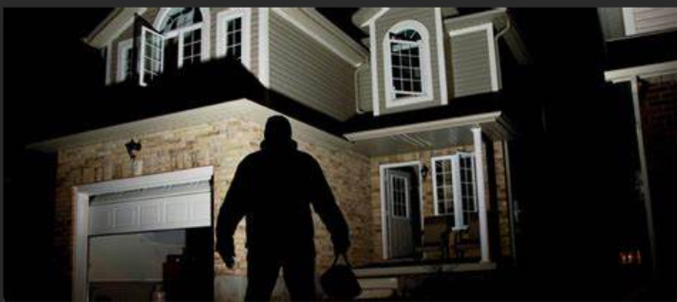
Introduction
Home invasion has increased in T&T. it can happen to anyone, and the results can lead to physical and emotional hurt/STRESS.
“Your home is your castle” It is therefore very important to create a safe and secure environment for you and your family.

Slide 3
UNDERSTANDING HOME INVASION
Home invasion is an American term which can be defined as unlawfully breaking and entering into a building or home while the LEGAL occupants are inside
In T&T While we use the term “HI”, This is not on our law books therefore the crimes are usually covered under the larceny act such as burglary etc.
Home invasion can lead to serious hurt such as rape, assault, injury, and even death

Slide 4
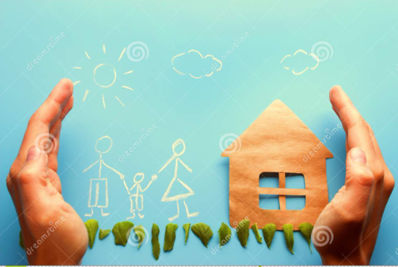
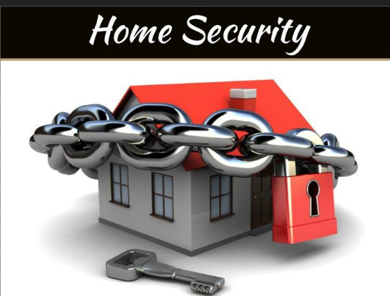
Security mind-set
Discuss with your family a security plan for your home as it relates to Home invasion
Remove expensive items from the public view

Slide 5
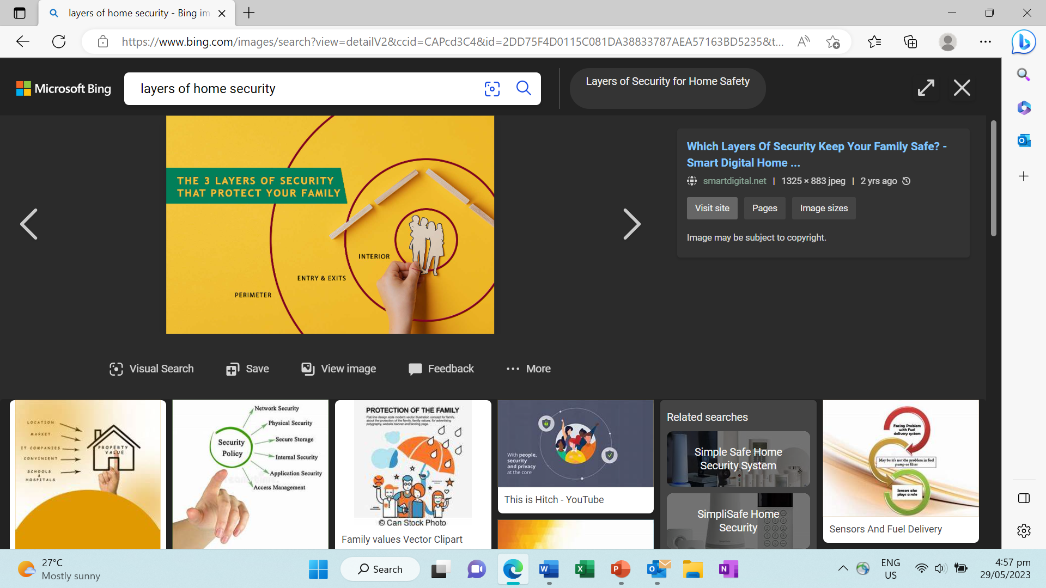
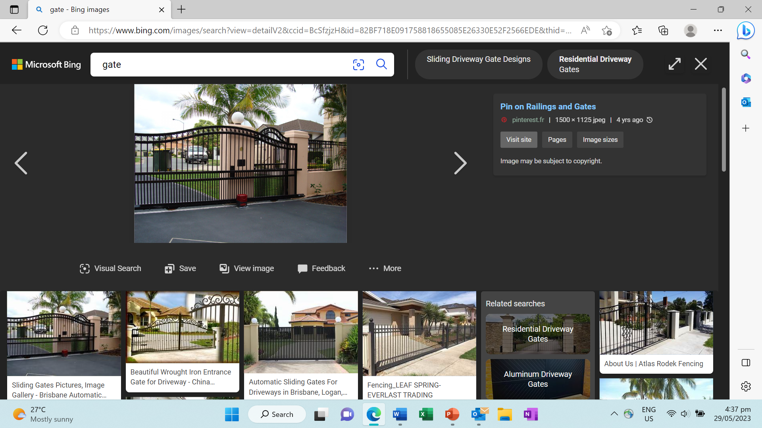
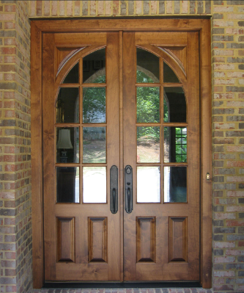
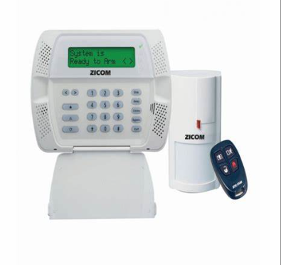
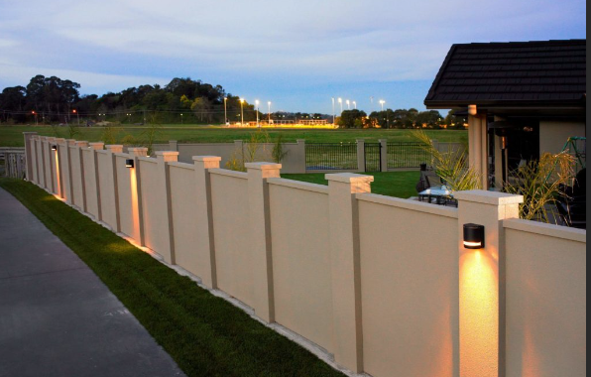
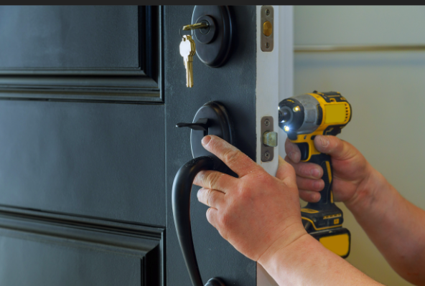
Strengthening perimeter security

Slide 6
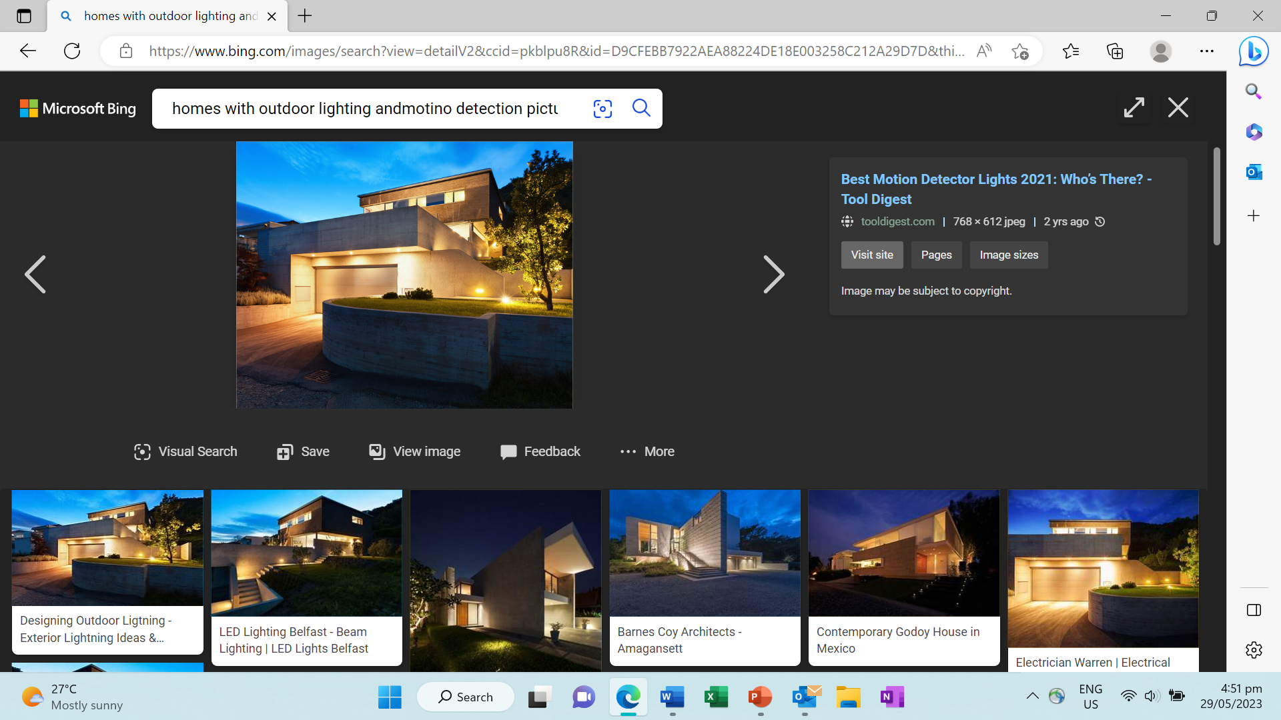
Outdoor Lighting and Landscaping
Adequate outdoor lighting helps deter criminals
Install motion-activated lights in strategic areas
Maintain well-trimmed bushes and trees near windows to eliminate hiding spots.

Slide 7
Alarm Systems and Surveillance
Install a reliable home security system with alarm monitoring
Consider using surveillance cameras to deter criminals and aid in identification

Slide 8
: Building Relationships with Neighbours
form a strong community network where neighbours look out for each other
Establish a neighbourhood watch program to promote safety and communication

Slide 9
Safe Habits and Daily Practices
Lock all doors and windows, even when at home.
Create the illusion of occupancy by using timers for lights and radios when away.
Clear mail boxes
Don’t put your name on your mail boxes
Clearly illuminate your home numbers

Slide 10
Social Media and Online Security
Caution against sharing vacation plans or personal information on social media.
the risks of oversharing and its potential impact on home security

Slide 11
Emergency Preparedness
Develop a family emergency plan, including escape routes and a designated meeting place.
how to use emergency communication systems and when to contact the authorities

Slide 12
Home Invasion Response
the importance of personal safety over property
strategies for dealing with a home invasion
safe room and calling 911.

Slide 13
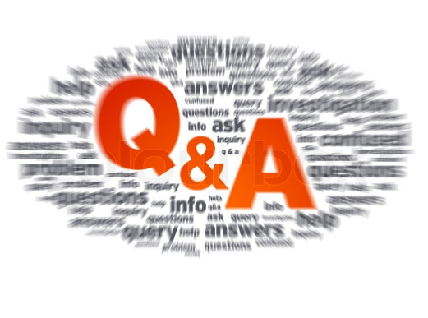
Notes:
Recap key points on home invasion prevention. Invite feedback to audience

