Slide 1
Mortgage Seminar Presentation

Slide 2

Do I need an Attorney?
All Deeds in Trinidad and Tobago by which property is transferred or mortgaged must be prepared by an Attorney-at-Law.
All Attorneys are qualified to undertake conveyancing work but not all are experienced in it so when searching for the right one, find an Attorney that specialises in residential property transactions known as a Conveyancing Attorney.

Slide 3

What is a Conveyancing Attorney?
A conveyancing Attorney is a specialist in the legal aspects of purchasing or selling a property and handles all of the legal aspects of buying and selling property including examining documents to ensure you are getting a fair deal, and verifying that the contract you are signing is valid and legal.

Slide 4

What does a Conveyancing Attorney do?
Being aware of what a Conveyancing Attorney does is a good place to start when getting your head around the complexities of buying (and selling) or mortgaging a home. In basic terms, they deal with the purchase of a property once you’ve had your offer accepted. But of course, the purchasing process is not a straightforward and simple one – and that’s why it is important to retain an Attorney to handle it for you.
If you are buying a new build, you should also consider choosing an Attorney that specialises in this area and who will have your best interests at heart. Sometimes this means not going with your developers recommended Attorney, and finding your own instead.
If you’re taking out a mortgage, the lender will require one of the Attorneys on its panel to be involved.

Slide 5

How does the conveyancing process begin?
Once you’ve found the right Attorney, you must ‘instruct’ them to get started on the job. The conveyancing process usually takes about 90 days to complete and there are a lot of steps to be completed.
Step one is to open the purchase file and advising you of the terms of business with details of their charges and the deposits required and asking the details of your estate agent, whether you need a mortgage for the purchase and if so, which lender you’re using and where the deposit is coming from.
You will also need to submit photo ID such as a passport or your driving licence and any other documents in compliance with your Attorney’s FIU obligations.
Next, they will contact the seller’s Attorney to let them know that they have been instructed to act for you with the purchase of the property. This is where the ball starts rolling and the paperwork begins to build. The seller’s Attorney usually sends over the draft agreement together with a copy of the Title Deed.

Slide 6

What will your Attorney do next?
Searches are a big part of the conveyancing process. The purpose of these searches is to uncover any potential issue that may interrupt the way of life within the property. Simply viewing or getting a survey on a property isn’t enough to know everything there is to know, and sometimes issues can be hidden away only to be discovered through a search and put a spanner in the works – and that’s why they are so important.
Alongside these searches, your Attorney will also be responsible for checking all the paperwork and any returned searches in great detail, raising any questions with the seller’s Attorney and making the buyer aware of any issues. If you do happen to run into any issues, this stage can take a few weeks and is often the culprit for any hold-ups, but it’s very important to get to the bottom of anything needing attention so that it’s plain sailing for the buyer once the purchase is complete.

Slide 7
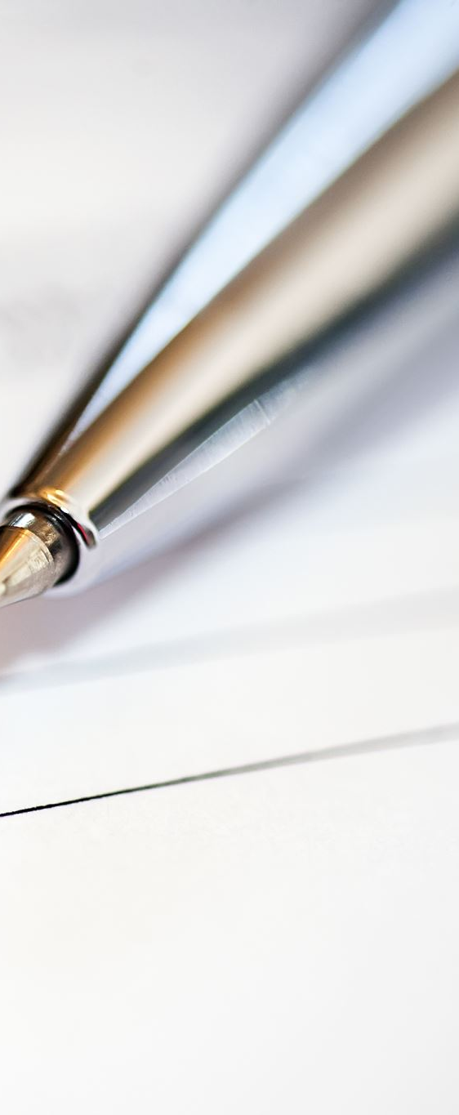
When do I sign and Pay ?
Once the Agreement is signed, sealed and delivered, the buyer is required to pay their deposit. This is usually 10% of the purchase price and can be done via online bank transfer or bank draft.
Once the Agreement is signed and deposit paid, the purchase becomes legally binding. This is the moment that you can breathe a sigh of relief, as you will have a legally binding contract to buy your new home and/or sell your existing home.
When the final completion statement is ready to go, you will need to pay any outstanding balances and your Attorney will request the balance of the mortgage amount from the bank or building society and give you a bill for their payment.
Only when the cash has been received by the seller’s Attorneys will the estate agents be authorised to release the keys for you. Then it’s up to you to pick the keys up and begin the moving in process!

Slide 8

Is there anything else that your Attorney will be responsible for?
Even though the conveyancing process is complete, your Attorney’s work doesn’t stop there. There’s usually a few loose ends to tie up before the case is closed, such as pay the Stamp Duty on your behalf, register the Deed with the Land Registry, send a copy of the title deeds to your mortgage lender.

Slide 9

What about if I’m selling?
It’s just as important for a seller to have an Attorney as it is for the buyer. As a seller, there are certain legal obligations that you must comply with, and you’ll need to draft and negotiate the terms of a contract before a property can be transferred. It’s always best to enlist the help of someone who really knows what they’re doing.
It works in quite the same way, in that your Attorney will be the point of call for the buyer’s Attorney in answering questions, solving issues and combing through contracts. They will deal with the property’s title deeds, handle the exchange of contracts and manage the day of completion, including handling the logistics involved with the all-important handover of keys.
Ultimately, their job is to lend their professional advice and expertise to ensure that the process is as smooth and stress-free for you as possible.
Buying a house can be lengthy and quite stressful at times. However, with the help of the right Attorney, it’s much, much easier. Do your research and put your trust into the right hands, and you’ll be unlocking the door to your new home for the first time before you know it.

Slide 10
Legal fees and stamp duty
Your Attorney’s fees cover all of the work required to complete the purchase of your new home, including submitting searches, checking the title, dealing with registration at the Land Registry and dealing with the payment of Stamp Duty.
Attorney’s Fees in Trinidad and Tobago are calculated based on the purchase price in accordance with the Attorneys-At-Law (Remuneration) (Non-Contentious Business) Rules of The Legal Profession Act Chap 90.03 and the table below gives some examples
CONSIDERATION |  | SCALE FEE |  | STAMP DUTY |  | STAMP DUTY -FIRST TIME HOMEOWNER
$ 1,000,000.00 |  | $ 7,000.00 |  | $ 7,500.00 |  | NIL
$ 1,500,000.00 |  | $ 9,500.00 |  | $ 30,750.00 |  | NIL
$ 1,750,000.00 |  | $ 10,750.00 |  | $ 12,000.00 |  | NIL
$ 2,000,000.00 |  | $ 12,000.00 |  | $ 55,750.00 |  | NIL
$ 2,250,000.00 |  | $ 13,250.00 |  | $ 74,500.00 |  | $ 12,500.00
$ 2,500,000.00 |  | $ 14,500.00 |  | $ 93,250.00 |  | $ 31,250.00
$ 2,750,000.00 |  | $ 15,750.00 |  | $ 112,000.00 |  | $ 50,000.00
$ 3,000,000.00 |  | $ 17,000.00 |  | $ 130,750.00 |  | $ 68,750.00
$ 3,250,000.00 |  | $ 18,250.00 |  | $ 149,500.00 |  | $ 87,500.00
$ 3,500,000.00 |  | $ 19,500.00 |  | $ 168,250.00 |  | $ 106,250.00
$ 4,000,000.00 |  | $ 22,000.00 |  | $ 205,750.00 |  | $ 143,750.00
$ 4,500,000.00 |  | $ 24,500.00 |  | $ 243,250.00 |  | $ 181,250.00
$ 5,000,000.00 |  | $ 27,000.00 |  | $ 280,750.00 |  | $ 218,750.00

Slide 11
Stamp Duty Conveyance on Sale
Exemption - Residential Property with a dwelling house exempt from stamp duty up to $850,000.00 - must be accompanied by:
Exemption Form
Lands and Buildings Taxes receipt
Current paid to date WASA bill
Document showing BIR File numbers of purchasers
Valuation Report
Residential Property
$0 to $850,000 | NIL with exemption
over $850,000 and less than $1,250,000 | 3%
over $1,250,000 and less than $1,750,000 | 5%
over $1,750,000 | 7.5%

Slide 12
Stamp Duty Conveyance on Sale
Exemption - Residential Property with a dwelling house exempt from stamp duty up to $2,000,000.00 for first time homeowners only from January 1, 2019 - must be accompanied by:
Exemption Form
Lands and Buildings Taxes receipt
Current paid to date WASA bill
Document showing BIR File numbers of purchasers
Sworn Affidavit from the Purchaser/s declaring that they are are first-time homeowner
Copy of National ID
Valuation Report
Residential Property – First Time Homeowner
$0 to $2,000,000 | NIL with exemption
over $2,000,000 and less than $2,250,000 | 5%
over $2,250,000 | 7.5%

Slide 13
Stamp Duty Conveyance on Sale
Exemption Residential Land –land approved for residential use is exempt from stamp duty to $450,000.00 - must be accompanied by:
Exemption Form
Land Tax receipt
WASA Clearance Certificate or paid WASA Bill
and either T&C Residential Land Letter or Copy of T&C Sub-division approval showing that land is approved for residential use
Document showing BIR File numbers of purchasers
Valuation Report
Residential Land
$0 to $450,000 | NIL with exemption
over $450,000 and less than $650,000 | 2%
over $650,000 and less than $850,000 | 5%
over $850,000 | 7%

Slide 14
Rates of Stamp Duty Conveyance on Sale
No Exemptions available
Commercial /Agricultural Land
$0 to $300,000 | 2%
$300,001 to $400,000 | 5% on whole
Over $400,000 | 7% on whole

Slide 15
Rates of Stamp Duty – Mortgages
*** ALL MORTGAGES IN FAVOUR OF A CREDIT UNION
ARE EXEMPT FROM STAMP DUTY
Exemption Residential Mortgage – where mortgage proceeds are used to purchase the property it is exempt from stamp duty up to $850,000.00 – must be accompanied by:
Exemption Form
copy of stamped Deed of Conveyance
Document showing BIR File numbers of borrower
Copy of stamped conveyance
 | Residential Property |  |  | Land Only
Now Buying | $0 to $850,000 | NIL with exemption |  | 0.2%
 | More than $850,000 | 0.2%
Already Owned | Amount of Mortgage consideration | 0.4% |  | 0.4%

Slide 16
Rates of Stamp Duty – Mortgages
*** ALL MORTGAGES IN FAVOUR OF A CREDIT UNION
ARE EXEMPT FROM STAMP DUTY
Exemption - Residential Mortgages with a dwelling house where mortgage proceeds are used to purchase the property it is exempt from stamp duty up to $2,000,000.00 for first time homeowners only from January 1, 2019 - must be accompanied by:
Exemption Form with a Statutory Declaration with copy of person’s ID
Copy of stamped conveyance document
Document showing BIR File numbers of purchasers
Letter from Financial Institution indicating that a mortgage facility has been granted to the Mortgagor as a first time homeowner
Residential Property – First Time Homeowner
$0 to $2,000,000 | NIL with exemption
over $2,000,000 | 0.2%

