Slide 1









ESTATE PLANNING, WILLS & PROBATE
WHAT IS IT?
&
Presented by:
Indira Mc Farlane-Lee
Attorney at Law
Governance Lead & Corporate Secretary
Massy Gas Products Portfolio
WHY DO IT?

Slide 2
Disclaimer
Be advised that this presentation is for general information purposes only
Please seek the advice of an Attorney at Law for specific legal advice relating to your situation

Slide 3
ObjectiveS of Presentation
To clarify the purpose, benefits and process of Estate Planning
To create an awareness of considerations to be made when planning
To discuss Wills and other methods for the disposition of property
To clarify misconceptions about Wills

Slide 4
Estate Planning
The making of a plan to carry out your wishes as to the distribution of your estate before or after death.

Slide 5
Estate – What is it?
Quantity, nature and extent of interest that a person has in real and personal property.
“Everything you Own”
Types of Property
Real Property | Personal Property
Everything permanently attached to a land or goes with the land. (Land & Building) | Everything other than real property, that is movable and tangible. (E.g. cash, cars, insurance policies, jewelry)
Notes:
Real Property ( Land and Buildings)
Personal property ( everything other than real property) eg cash, cars, insurance policies, jewelry)

Slide 6
Distribution of Estate
An estate can be distributed in 3 broad ways :-
Inter Vivos (while alive)
Under Testacy (after death but pursuant to a Will of the deceased)
Under Intestacy (after death but there is no Will)

Slide 7
Testacy
Leaving a valid will at one's death to direct the distribution of one's estate.

Slide 8
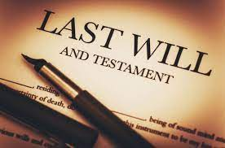

Slide 9
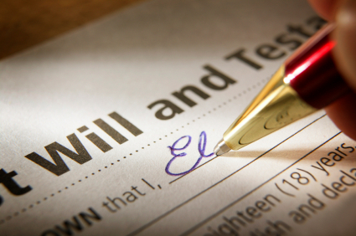
WHY SHOULD I LEAVE A WILL?
A Will is a legal document in which a person (the testator) declares their intention as to what should happen to their estate after their death, and which is executed in accordance with certain legal formalities.
By making a Will, you decide who gets what portion of your Estate at a time when you are of sound mind.
You decide who will be appointed to carry out your wishes as stated in the Will (Executor)

Slide 10
Requirements for a Will:
The will must be in writing
The will must be made by a person who has attained the age of 18
The Testator must have mental capacity
The will must be signed by the Testator
Signature at foot or end of Will

Slide 11
Requirements for a Will (cont’d) :-
Testator must sign his will, in the presence of two witnesses who must both be present when the signature is made
Witnesses must sign in the presence of the testator
NOTE: A BENEFICIARY UNDER A WILL CANNOT WITNESS THE WILL, AS THIS WILL NULLIFY HIS/HER GIFT
Notes:
can be set aside if testator not sound of mind- advise for older person get a letter from a doctor certifying testamentary capacity/ undue influence

Slide 12
Wills- Cont’d
Will takes effect upon death
Wills can be revoked
Wills are revoked upon Marriage but not upon Divorce
Fraud or undue influence will invalidate a Will
Notes:
- If the gift no longer exists at time of death, the gift is void. Note you can treat with your assets up to death

Slide 13
Considerations in Preparing Will
Have an Attorney prepare the Will
Have a list of assets prepared (not jointly held /or named beneficiaries)
Who are:
The Executors (you can name up to four Executors)
The Beneficiaries (including residuary estate)
Can name Guardians of minors
Securing your will
Considerations for distribution of property among multiple beneficiaries and occupiers
Property with no Deed
Joint tenancy vs tenancy in common
Where the property is located
Notes:
Executors- over 18, trustworthy, should ideally be younger than you are
Securing your will -can place the will in the depository of wills at the High Court- make an appointment- only executor can take the will out after death

Slide 14
Role of the Executor
The Executor has the responsibility of applying to the High Court for a Grant of Probate, paying any debts, expenses of the Estate and of distributing the Estate of the deceased in accordance with the Will
Should be over 18
Should be someone you trust
Ideally be younger than you- consideration to appoint at least two
Discuss with the Executor his/her appointment
Provide a copy of Will/ inform them where it is located
Inform them if the Will is revoked
Provision for expenses to Probate the Will

Slide 15
Common Misconceptions!
Wills are expensive and time consuming
Only the rich need to do Wills
I am too young for a Will
My family knows my wishes so I don’t have to do a Will / Telling someone my wishes has the same effect as a Will
That entitlement happens upon death of testator
Wills are irreversible
A beneficiary loses entitlement if they die after testator but before distribution
That Wills have to be registered to take effect

Slide 16
Intestacy
If you die without a Will, the Law (not you) determines who gets what share of your Estate.
The Law also determines who has the right to apply for your Estate (Letters of Administration).
Common Law relationships.
Notes:
Apply means apply to administer not who is entitled to benefit from the Estate. Issue where multiple people are entitled to apply. Show your relation ship to deceased, produce original marriage, birth certificates etc
Section 23-26 C of the Administration of Estates Act
Letters of Administration - Section 30 of Wills and Probate Act
Common Law relationships Distribution of Estates Act No 28 of 2000 ( amended Administration of Estates Act)

Slide 17
Distributing Property Before Death (Inter Vivos)
Benefits
Ensure your wishes are fulfilled/Reduce conflict/Reduce administrative burden/expense
Considerations
Deeds (consider impact of joint vs tenancy in common)
Life tenancy
Joint Accounts
Insurance Policies
Physically distributing belongings
Disadvantages
May require consent of beneficiary to revoke
Notes:
Assets- in general good idea to list your assets, accounts, policies, pension plan, life insurance policies and share with loved ones whether you make a will or not – should be updated from time to time
Discuss draw backs of gifts

Slide 18


